Slide 1
Liberty Ranch Agriculture Program Courses
2021-2022 School Year

Slide 2
​ SUBJECT AREA​ ​ | ​ GJUHSD Graduation Requirements​ Class of 2021 and on​ 280 credits​ | UC/CSU​ “A-G” REQUIREMENTS​ (Must complete course with a C or better )​ https://hs-articulation.ucop.edu/agcourselist#/list/details/1684/ ​
​ Social Science​ | ​ 30 Credits ​ - 10 credits of World History (10th)​ - 10 credits of US History (11th)​ - 5 credits of Economics (12th)​ - 5 credits of American Government (12th)​ | ​ A) 2 years of Social Science ​ - 1 year of World History​ - 1 year of US History​
​ English​ | ​ 40 credits:​ - English 1, 2, 3, 4​ | ​ B) 4 years required​ ​
​ Math​ ​ | ​ 30 credits ​ -Must complete Algebra 1 or Integrated Math 1​ ​ | ​ C) 3 years required (4 years are recommended)​ (Starting with Algebra 1 or Integrated Math 1)​ ​
Science​ | ​ 30 credits ​ - 10 credits of Physical Science​ - 10 credits of Life Science​ - 10 credits of another science​ ​ | ​ D) 2 years of lab science (3 years are recommended)​ - 1 physical science ​ - 1 life science​
Language other than English & VAPA (Visual and Performing Arts)​ ​ | ​ 20 credits of Language other than English​ (We offer Spanish and German)​ ​ 10 credits of Visual and Performing Arts ​ ​ | ​ E) 2 years required of the same Language Other than English (3 years are recommended)​ ​ F) 1 year of a Visual and Performing Arts course​ ​
Electives​ | 95 credits​ | G) 1 year of a College Preparatory Elective​ ​
Physical Education​ ​ | 20 credits​ -All freshman take PE 9 (Physical Fitness Test is also given)​ | Not a requirement​
Health​ | 5 credits ​ | Not a requirement​

Slide 3
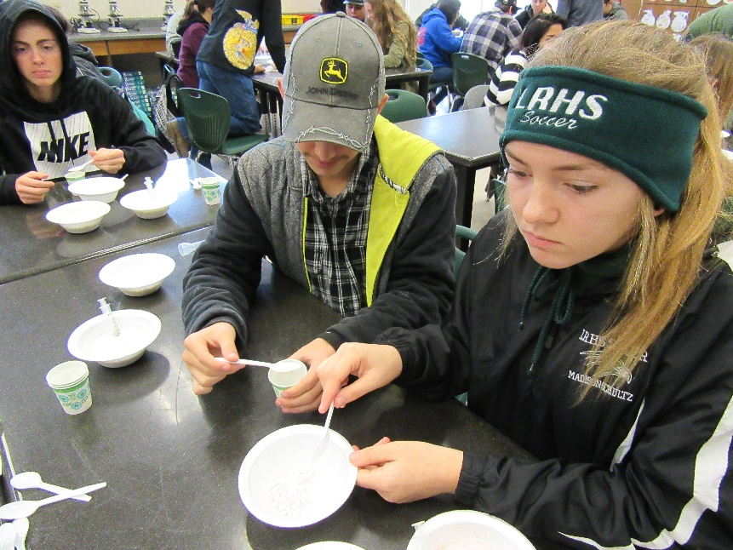
Agriscience Pathway
9th Grade Sustainable Agriculture Biology
10th Grade Chemistry in Agriscience
11th Grade Advanced Interdisciplinary Science for Sustainable Agriculture
12th Grade Agricultural Government and Economics

Slide 4
Agriculture Biology
Focuses on molecular biology principles and sustainable agriculture practices.
Meets UC/CSU Life Science requirements
Open to ALL grades

Slide 5
Chemistry in Agriscience
Focuses on the chemical nature of plants, animals, and soils and their connection to current agriculture practices
Meets UC/CSU Physical Science requirements
Open to 10th, 11th, and 12th graders
Satisfactory completion of Sustainable Agriculture Biology

Slide 6
Advanced Interdisciplinary Science for Sustainable Agriculture
Focuses on exploring and applying agriscience concepts in biotechnology and soil science to better the Liberty Ranch FFA Sustainable Farm
Meets UC/CSU Life Science requirement
Open to 11th and 12th graders
Satisfactory completion of Sustainable Agriculture Biology and Agriculture and Soil Chemistry.
Opportunity to receive Honors credit

Slide 7
Agricultural Government & Economics
Year-long course; One semester of Economics and One Semester of Government
Meets UC Government and Economics requirements
Open to 12th graders ONLY

Slide 8
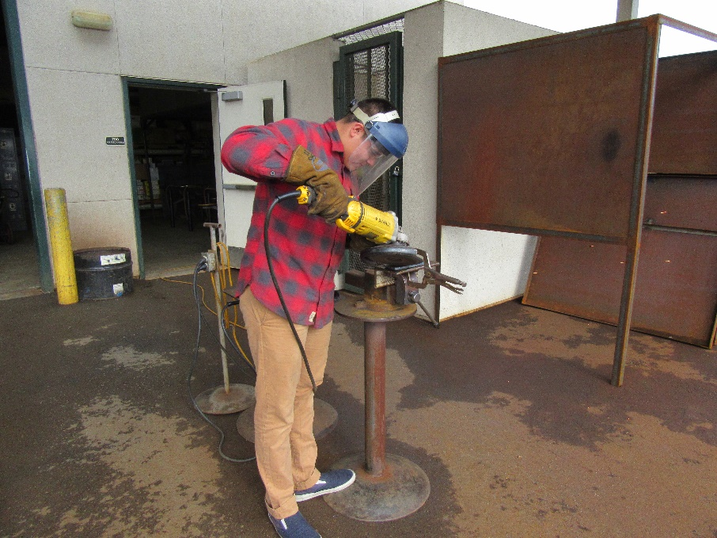
Agriculture Mechanics Pathway
Year 1 Agriculture Mechanics Skills and Technology
Year 2 Agriculture Metals and Welding
Year 3/4 Agricultural Welding and Fabrication ROP

Slide 9
Agriculture Mechanics Skills and Technology
Project-Based shop class that focuses on skills and competencies in various mechanical fields including metalworking, woodworking, plumbing and irrigation, electrical principles and wiring.
Meets Elective Credit
Open to 9-12 graders

Slide 10
Agriculture Metals and Welding
This course includes oxyacetylene welding (OAW), oxyacetylene cutting (OFC-A) and shielded metal arc welding (SMAW) processes, in the flat and horizontal positions on various joint details.
Meets Elective Credit
Opportunity for College Articulation credit
Open to 10-12 graders
Satisfactory completion of Agriculture Mechanics Skills and Technology

Slide 11
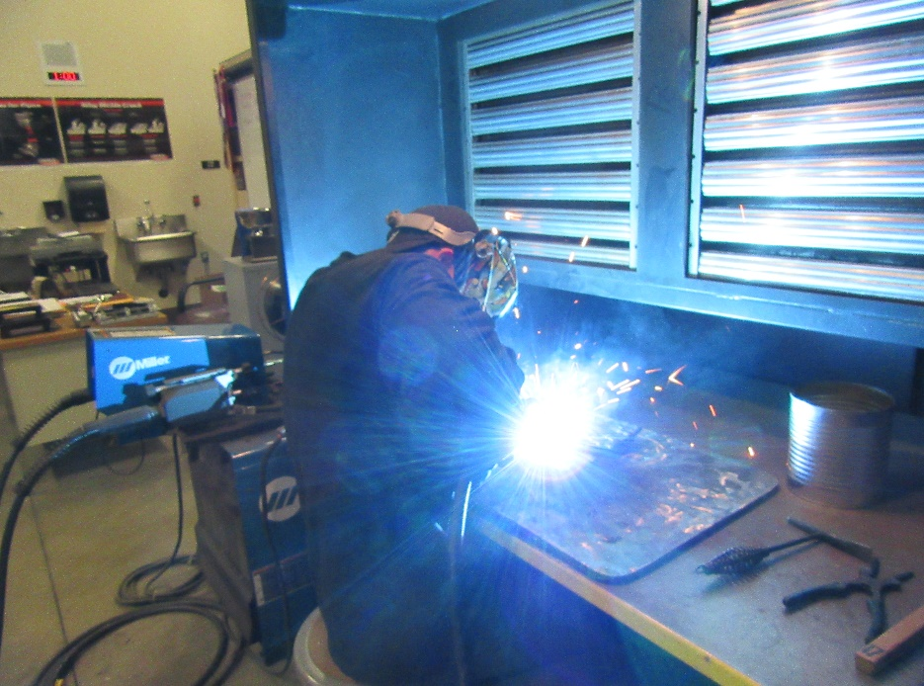
Agricultural Welding and Fabrication
Students will learn specialized welding skills and practices including the nature of identification of metals, concentration on out-of-position Shielded Metal Arc Welding (SMAW), GMAW (MIG) with micro and core wire, GTAW (TIG) of non-ferrous metals (aluminum and stainless steel), cast iron welding, hard surfacing, plasma arc cutting, and freehand and automatic shape burning.
Meets Elective Credit
Opportunity for College Articulation credit
Open to 10-12 graders
Satisfactory completion of Agriculture Metals and Welding

Slide 12
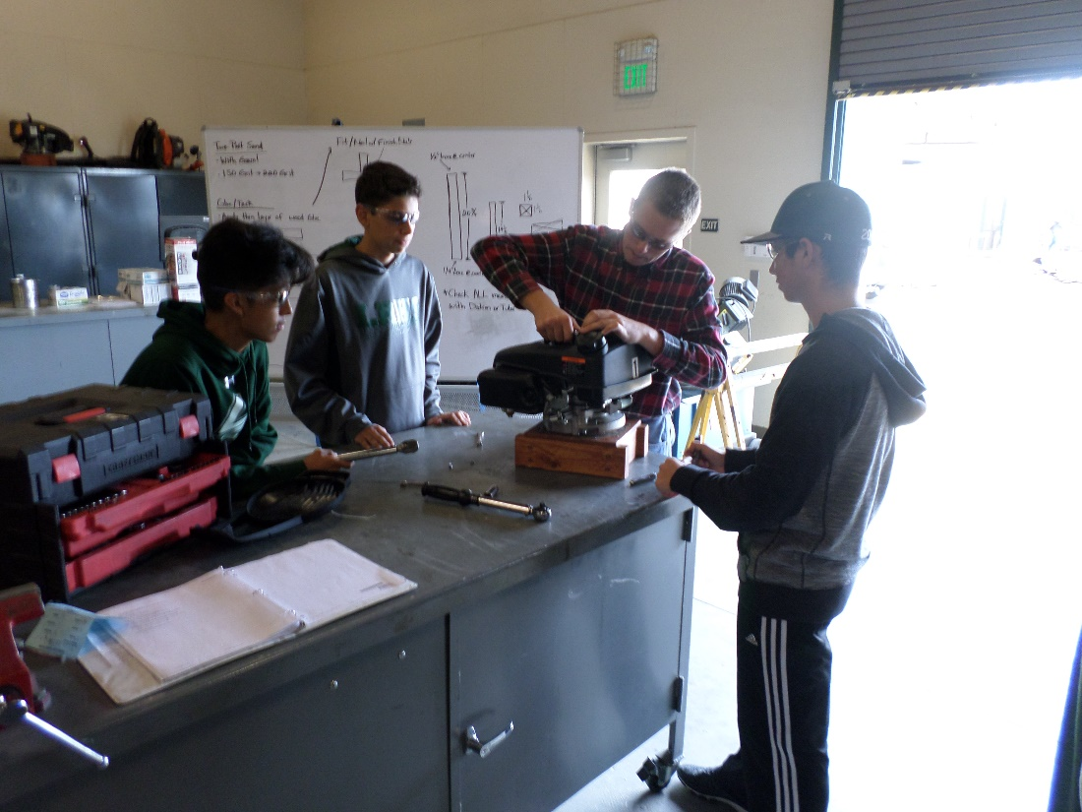
Agricultural Power Mechanics Pathway
Year 1 Agriculture Mechanics Skills and Technology
Year 2 Agricultural Power Mechanics I

Slide 13
Agricultural Power Mechanics I
Review Engine functions and operation
Complete Breakdown and Rebuild of compact diesel engine.
Work on personal projects
Meets Elective Credit
Open to 10-12 graders

Slide 14
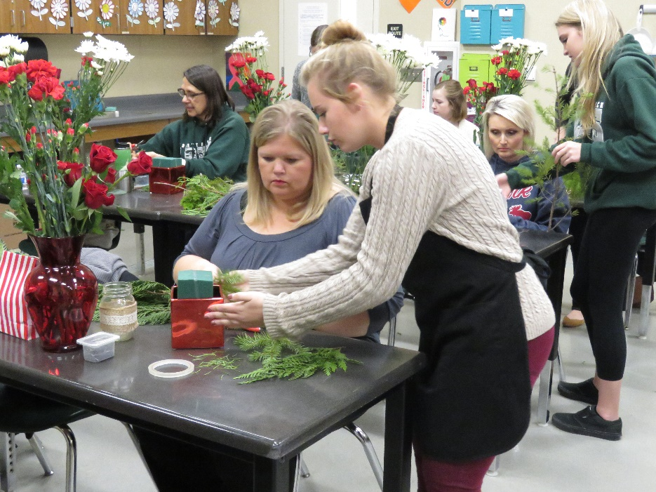
Floriculture and Ornamental Horticulture Pathway
Year 1 Introduction to Elements and Principles of Floral Design
Year 2 Advanced Art and History of Floral Design
Year 3 Environmental Horticulture

Slide 15
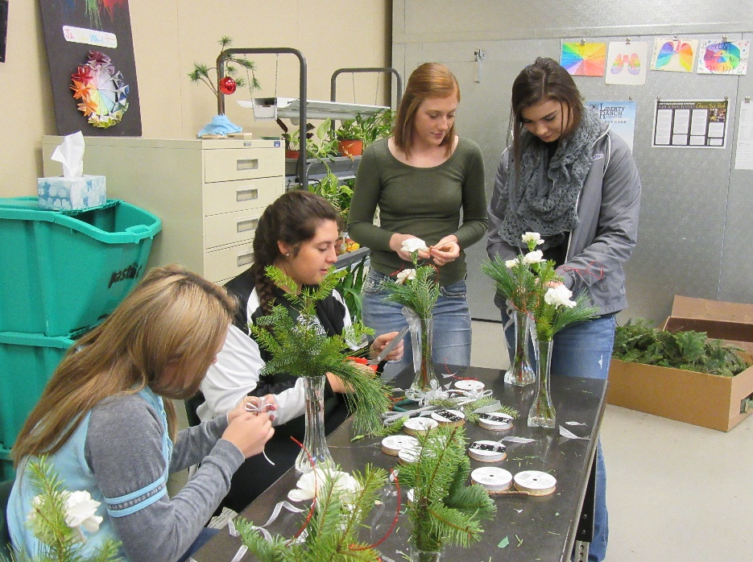
Introduction to Elements and Principles of Floral Design
Students will practice the elements and principles of art through horticulture and floriculture laboratories. Students will create over twenty floral arrangements as well as grow plants in the greenhouse as a part of class.
Meets UC Fine Art Credit
Open to 9-12 graders

Slide 16
Advanced Art and History of Floral Design
Students enrolled in Advanced Floral Design have the opportunity to work as a professional florist running the “Liberty Ranch Floral Crew” Shop. Students perfect their floriculture and horticulture skills as they design for events and holidays on and off-campus. Students have the ability to earn a profit on indoor plants grown as a part of class and sold at plant sale.
Meets UC Fine Art Credit
Open to 10-12 graders

Slide 17
Environmental Horticulture
Students will learn skills in production plant growing and tending. Instruction includes plant propagation, soil mixtures, and sterilization, irrigation, potting and canning, fertilizers, floral design, pesticides, greenhouse operations, plant identification, tools and materials, basic landscaping and business management.
Meets UC Biology/Life Science Requirements
Must have taken Introduction to Elements and Principles of Floral Design

Slide 18
Other Electives

Slide 19
Leadership in Agriculture
This year-long course is designed to engage students in experiential activities, which further their personal development and leadership skills. Students will also have the opportunity to prepare for Career Development Events and spend a significant portion of the class-time working within FFA Service Committees, which serve a myriad of purposes and functions of our FFA chapter.
Meets Elective Credit
Open to 10-12 graders

Slide 20
Food Science: Farm to Fork
Students will apply plant science concepts as they learn to grow their own food in their garden plot. Students will practice various processing, packaging, and food preparation techniques to ultimately eat local, healthy, fresh food. This class will teach students about nutrition, farming, and cooking and allow students to experience first-hand the process from Farm to Fork.
Meets Elective credits
Open to 10-12 graders

